Slide 1
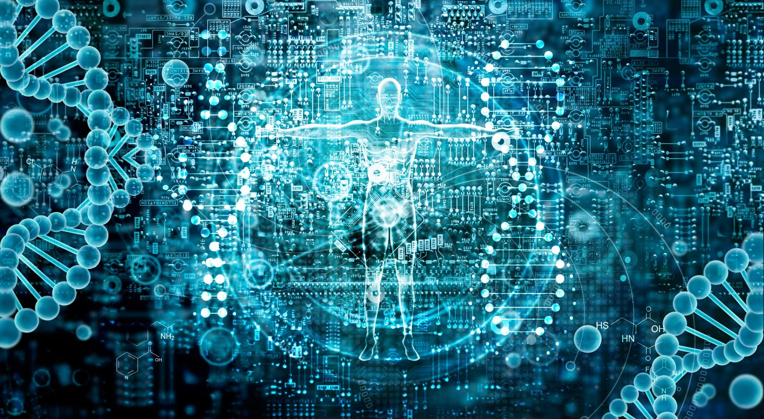
Bioinformatics
Intro to
Through phylogenetics
Lecture by Prof. Dominic Evangelista
Adelphi University
Computational Biology

Slide 2
Bioinformatics
What is it?
Research, development, or application of computational tools and approaches for expanding the use of biological, medical, behavioral or health data, including those to acquire, store, organize, archive, analyze, or visualize such data.

Slide 3
Bioinformatics
What aspect of it will we cover?
BLAST
(Partial) genome annotation
Phylogenetics pipeline
Acquisition of genetic data
Processing
Analysis

Slide 4
Review: Homology
Old definition
the same feature in different organisms under every variety of form and function
New definition
a feature in two or more taxa that is derived from a single a corresponding feature of their common ancestor

Slide 5
Review: 3 types of homology
Orthology
a feature found in multiple lineages that is derived the splitting of species
Paralogy
features found in one or more lineages that are derived from a duplication within a single organism
Xenology
Features found in one or more lineages that are derived from horizontal transfer between lineages

Slide 6
Species 1
Ancestor
Species 2
This phylogeny shows the relationships of two species and their common ancestor.

Slide 7

Species 1
A1
Ancestor
A2
Species 2
Over the evolutionary history of this clade, we can also look at the evolutionary history of a trait…like a leaf.
Trait A1 and A2 are orthologous.

Slide 8


Species 1
A1
Ancestor
A2
Species 2
The leaf’s phenotype may not change (as in the last slide), or it might change (like in this slide).
Trait A1 and A2 are orthologous.

Slide 9


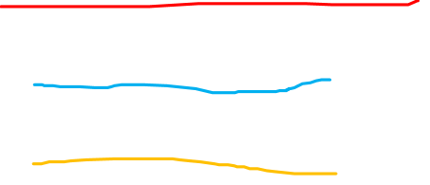
Species 1
A1
Ancestor
A2
B2
Species 2
Now…after the speciation event but before the present day, a mutation occurred that results in Species 2 displaying more than 1 kind of leaf.
Trait A1 and A2 are orthologous.
Trait A1 and B2 are orthologous.
Trait A2 and B2 are paralogous.

Slide 10

Species 1
A1
Ancestor
C1
A2
Species 2
In this situation, there was a horizontal transfer of the gene coding for the leaf in the top lineage into the bottom lineage. As a result, species two shows two traits.
Trait A1 and A2 are orthologous.
Trait A2 and C1 are xenologous.

Slide 11
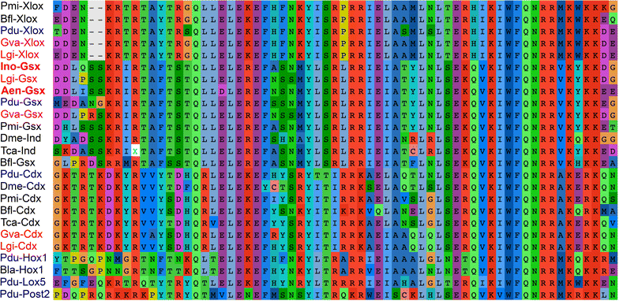
Most homologizing in the 2000s is done with molecular (DNA, RNA, protein) traits.
Molecular characters don’t have developmental origins, their context isn’t usually obvious, paralogy is rampant, xenology occurs and is difficult to determine, function is often unknown…

Slide 12
Bioinformatics
What aspect of it will we cover?
BLAST
(Partial) genome annotation
Phylogenetics pipeline
Acquisition of genetic data
Processing
Analysis

Slide 13
BLAST
Basic Local Alignment Search Tool
Extremely fast way to search for matches of strings in a database
Part 1: Smith-Waterman algorithm https://www.youtube.com/watch?v=jzSIC2UzxZ4
Part 2: BLAST protocol https://www.youtube.com/watch?v=wfi_KimrNQM

Slide 14
Bioinformatics
What aspect of it will we cover?
BLAST
(Partial) genome annotation
Phylogenetics pipeline
Acquisition of genetic data
Processing
Analysis

Slide 15
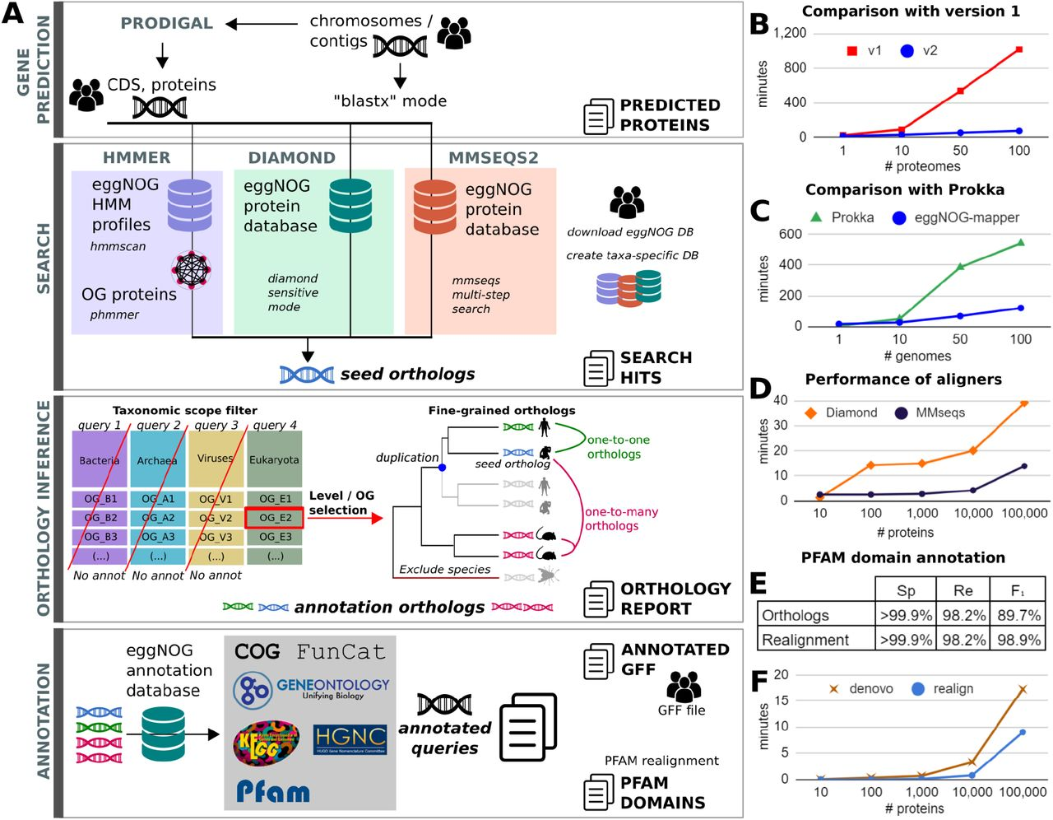
Genome annotation
Take a sequenced genome (molecular string only) and ascribe functions to its parts
E.g. EggNOG mapper

Slide 17
Notes:
The gene prediction stage uses Prodigal to perform protein prediction from assembled contigs. During the search stage, HMMER3, Diamond, or MMseqs2 can be used to align the input proteins to eggNOG v5.

Slide 18
Notes:
During the orthology inference stage, a report of orthologs is generated based on the desired taxonomic scope. Finally, protein annotations and domains are transferred from orthologs to the queries and reported as tabular and GFF files.

Slide 19
Bioinformatics
What aspect of it will we cover?
BLAST
(Partial) genome annotation
Phylogenetics pipeline
Acquisition of genetic data
Processing
Analysis

Slide 20
Phylogenetics pipeline
Choose taxa and genes
Acquire orthologous genetic data (molecular phylogenetics)
Assess homology of data
Infer evolutionary relationships
Assess support
Optional: Downstream biological analyses
Examples
Divergence data inference
Ancestral state reconstruction
Diversification analysis

Slide 21
Phylogenetics pipeline
Choose taxa
Acquire orthologous genetic data (molecular phylogenetics)
Assess homology of data
Infer evolutionary relationships
Optional: Downstream biological analyses
Examples
Divergence data inference
Ancestral state reconstruction
Diversification analysis
What is your goal?

Slide 22
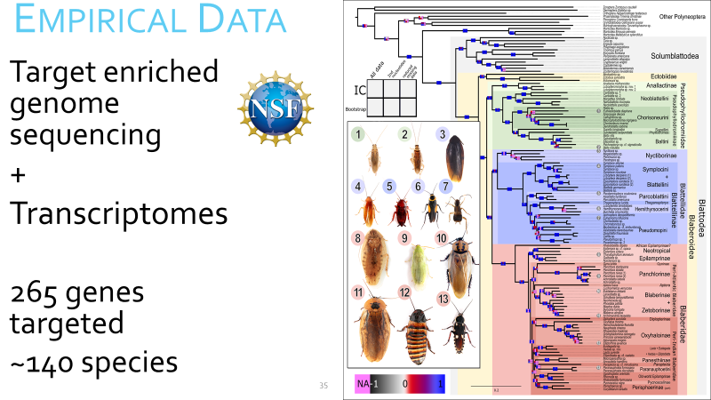
Phylogenetics pipeline
Choose taxa and genes
organismal analysis
Multiple or single species? (macro or microevolution?)
Multiple orthologous genes necessary
Gene or protein analysis
Single gene or multiple genes?
Single species or multiple species?

Slide 23
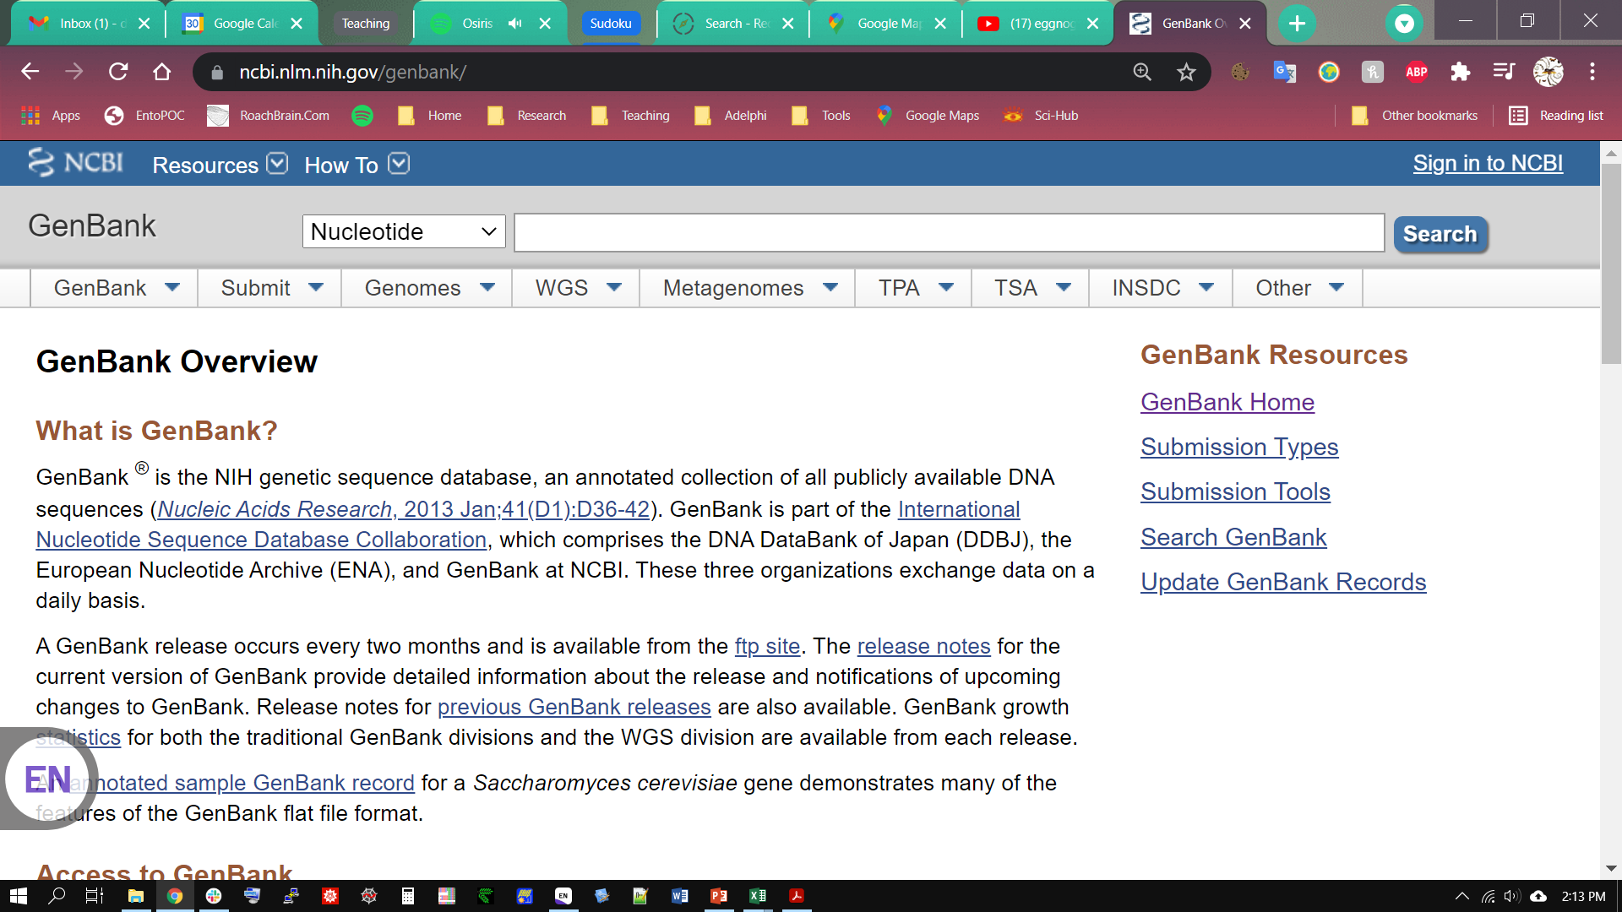
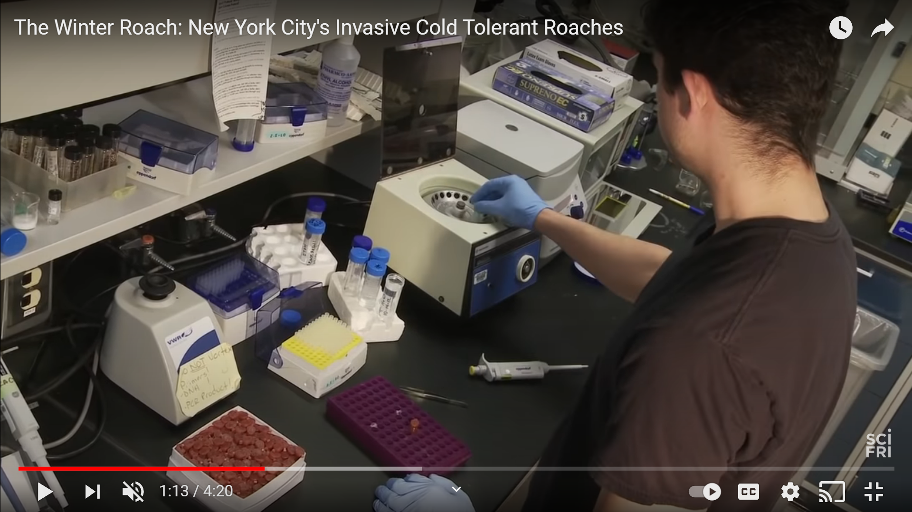
Phylogenetics pipeline
Acquire orthologous genetic data (molecular phylogenetics)
Download from NCBI
If annotated, test with BLAST
If not annotated assess with annotator (e.g., EggNOG)
Collect de novo (sequencing)
Clean, trim sequences
Assess accuracy (BLAST) and annotate

Slide 24
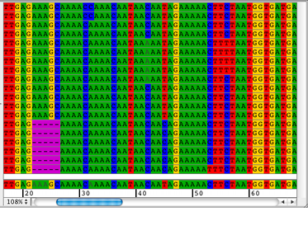
Phylogenetics pipeline
Assess homology of data independently (gene by gene)
Align automatically (e.g., MUSCLE, CLUSTAL, MAFFT)
Refine manually
Optional: mask
Repeat

Slide 25
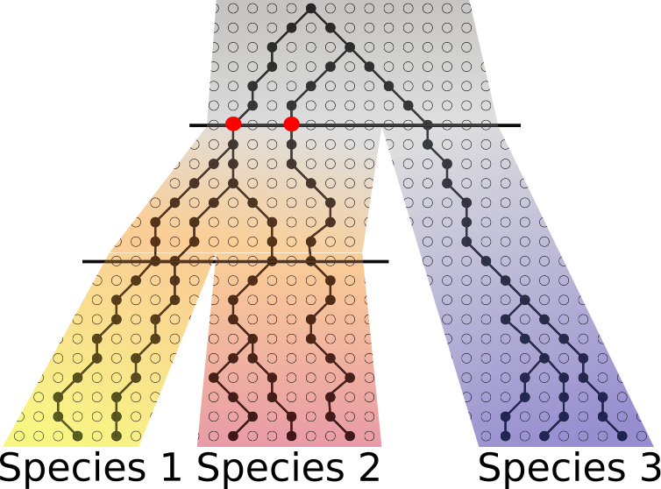
Phylogenetics pipeline
Infer evolutionary relationships
Concatenate sequences?
Choose method: Maximum Likelihood, Bayesian, parsimony, neighbor-joining
Run method with biologically justified parameters and partitioning
Analyze genes separately
Choose method for each gene (see above)
Species tree method

Slide 26
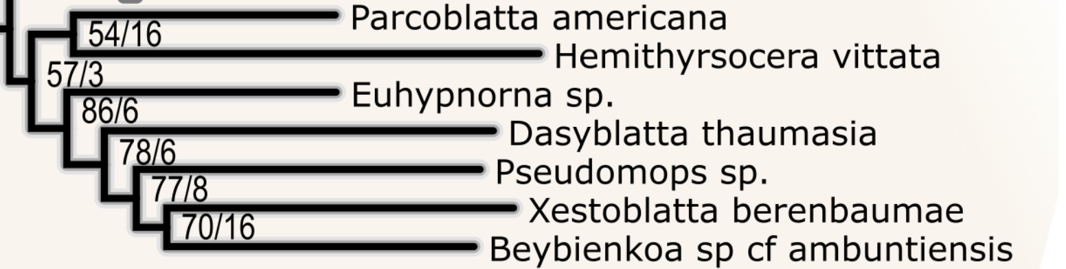
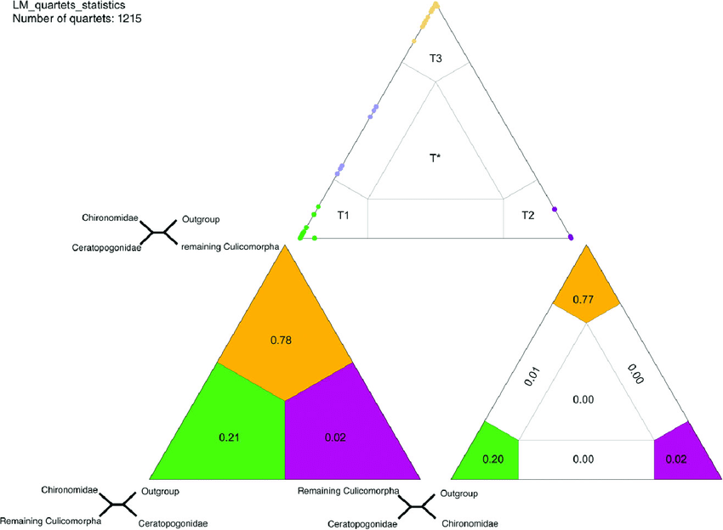
Phylogenetics pipeline
Assess support
Assess repeatability with data
Bootstrap, jack-knife, posterior probability, AU-Test
Assess internal consistency and sources of bias
Compare with gene tree relationships
Data randomization tests (e.g., quartet likelihood-mapping)
Assess congruence with other datasets
Compare with other studies or other data (e.g., morphology)
Assess support for alternative trees

Slide 27
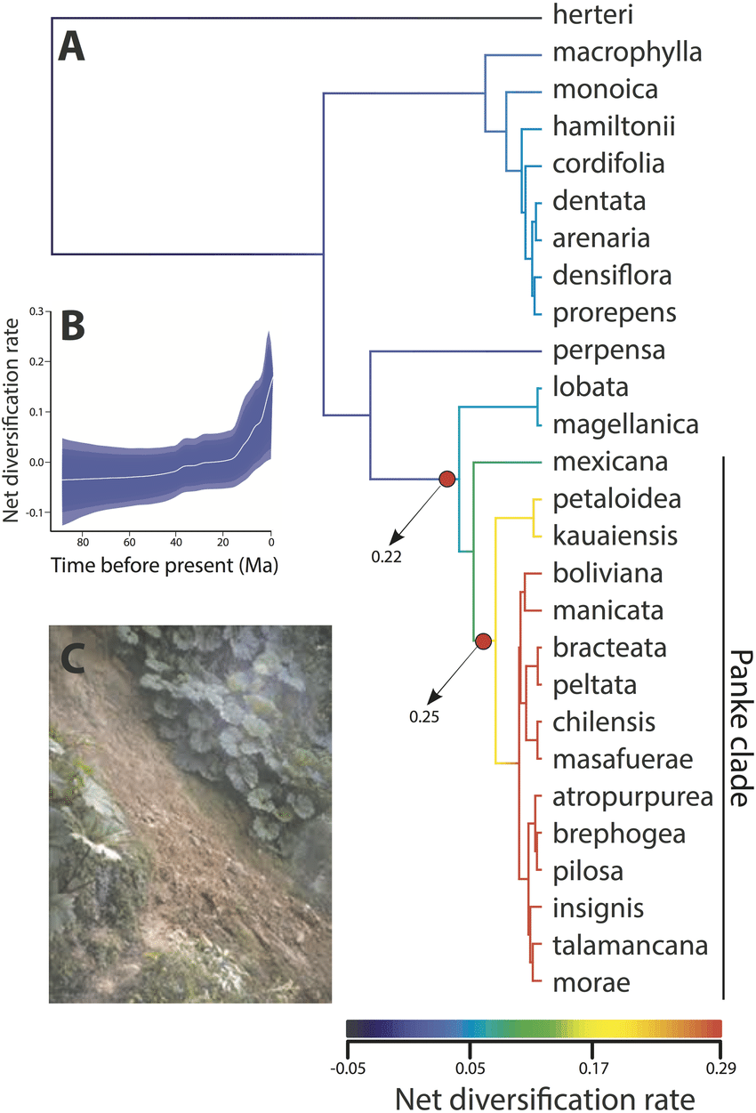
Phylogenetics pipeline
Optional: Downstream biological analyses
Examples
Divergence data inference
Ancestral state reconstruction
Diversification analysis
May require collecting additional data
May take longer than previous analyses
Usually have wider confidence values (explicit and implicit)

Slide 28
Phylogenetics pipeline
Choose taxa and genes
Acquire orthologous genetic data (molecular phylogenetics)
Assess homology of data
Infer evolutionary relationships
Assess support
Optional: Downstream biological analyses
Examples
Divergence data inference
Ancestral state reconstruction
Diversification analysis

Slide 29
Bioinformatics
Phylogenetics pipeline
Integrates…
Database searching (BLAST, NCBI, annotation)
Algorithms for assessing homology
Modelling
Big data (optional) and batch processing

